Slide 1

Modular Programming for AI
Today’s Agenda
What is Modular Programming?
Python Modules: Built-in & Custom
Importing & Using Modules
Creating & Structuring Your Own Modules
Common AI Libraries
Hands-On Practice
Kahoot(Quiz)

Slide 2
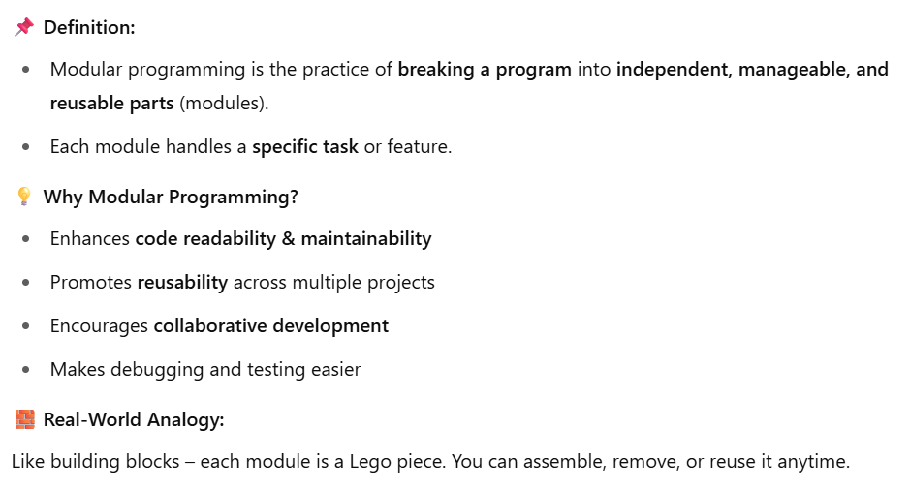
What is Modular Programming?

Slide 3
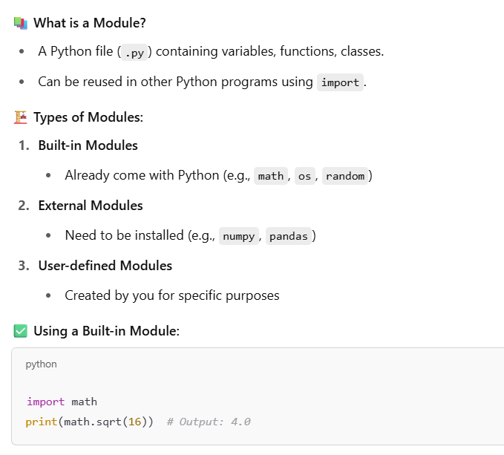
Python Modules – Built-in & External

Slide 4
Short Break(10 min)

Slide 5
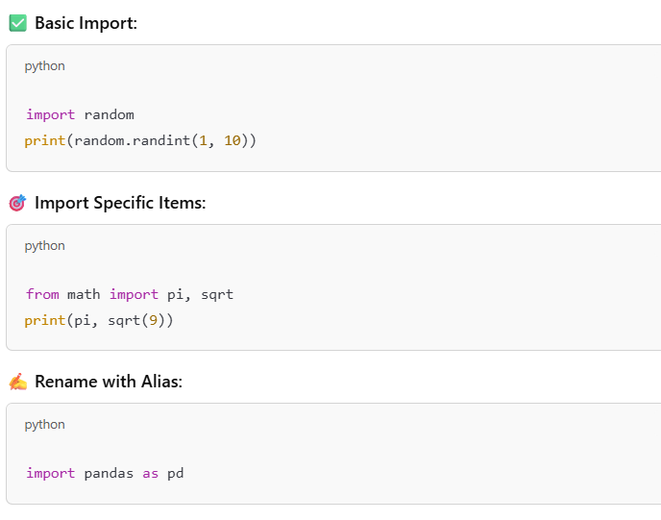
Importing Modules – Syntax & Techniques

Slide 6
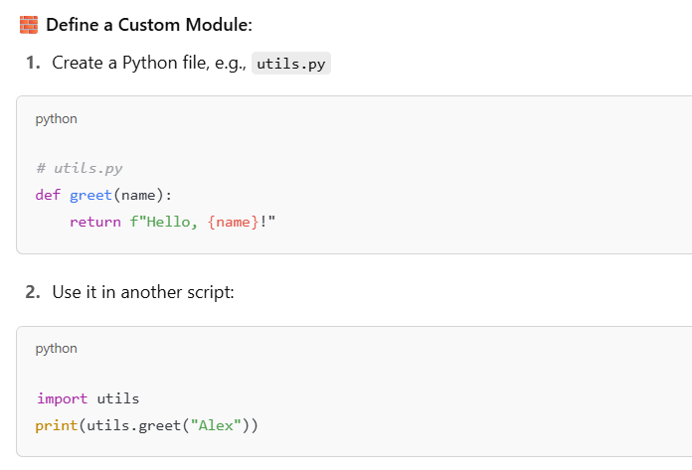
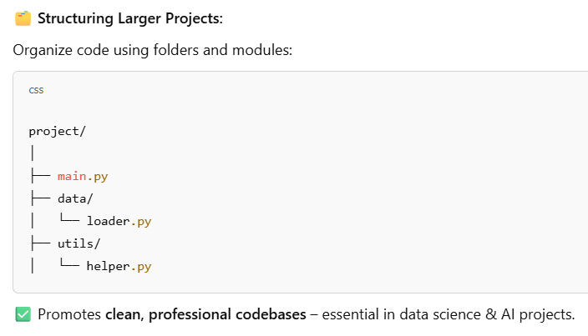
Creating Your Own Python Module

Slide 7
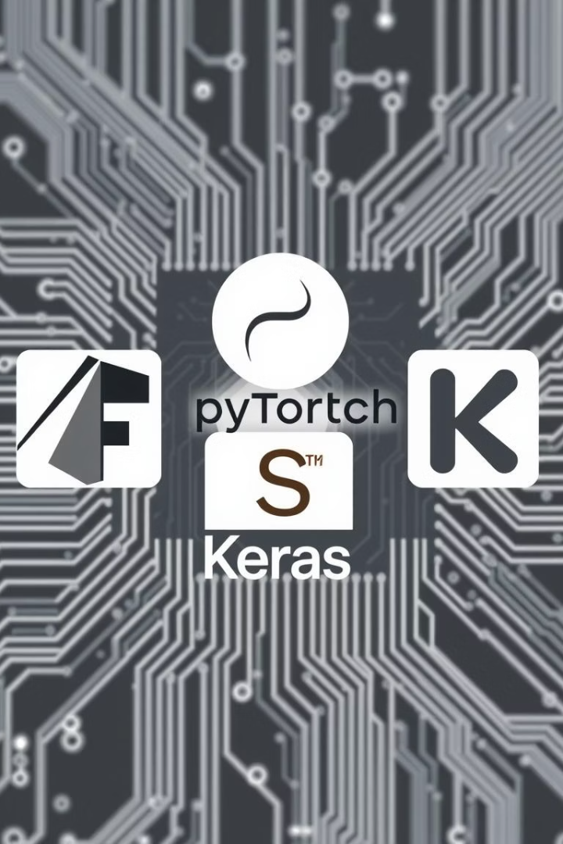




Common AI Libraries Import
Data Manipulation
Visualization
Machine Learning
matplotlib, seaborn
sklearn modules
numpy, pandas
Deep Learning
tensorflow, keras

Slide 8
Main Break(30 min)

Slide 9
QnA
And
Feedback
Next: File Handling & Exceptions

